Slide 1
Where Once There Was a Wood
By Denise Fleming
Reading and Powerpoint by Cate Milburn

Slide 2
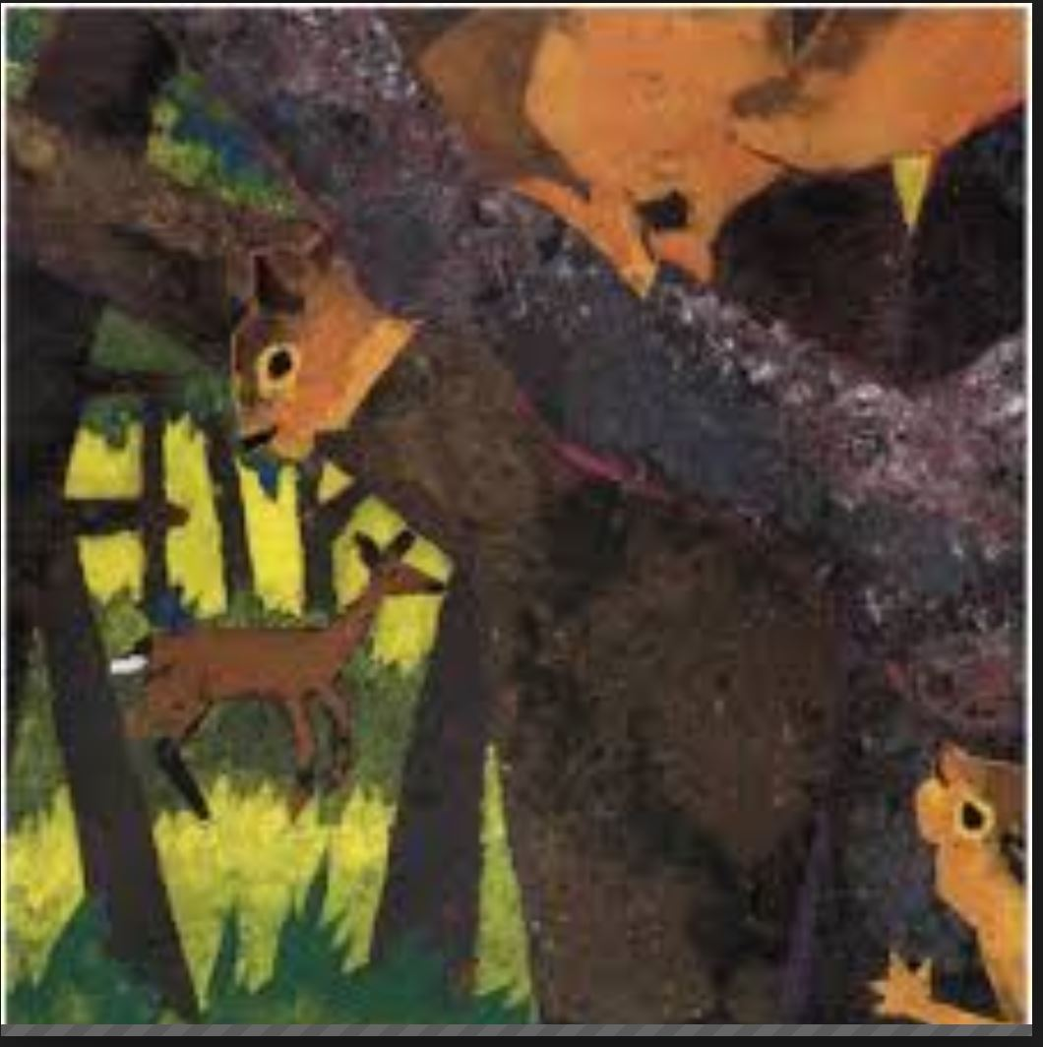
Where once there was a wood

Slide 3
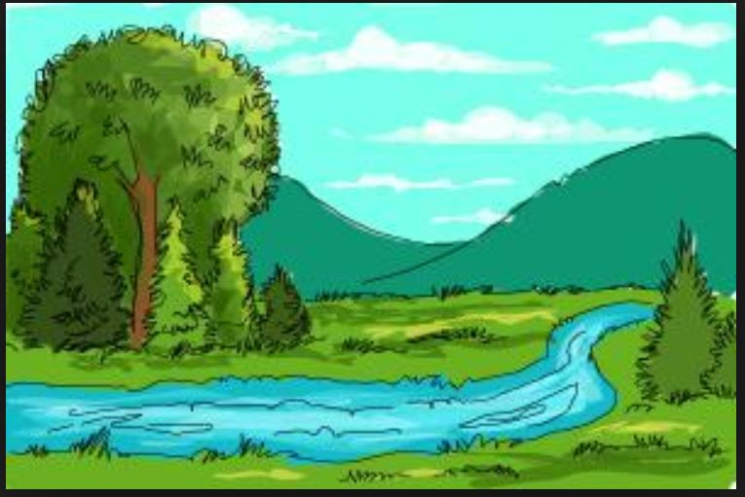
a meadow and a creek

Slide 4
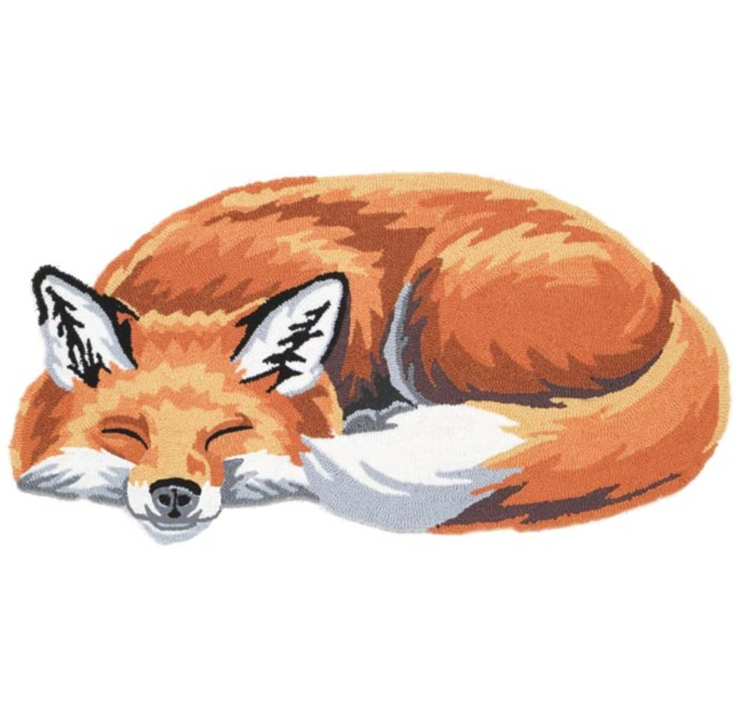
where once the red fox rested and closed his eyes to sleep

Slide 5
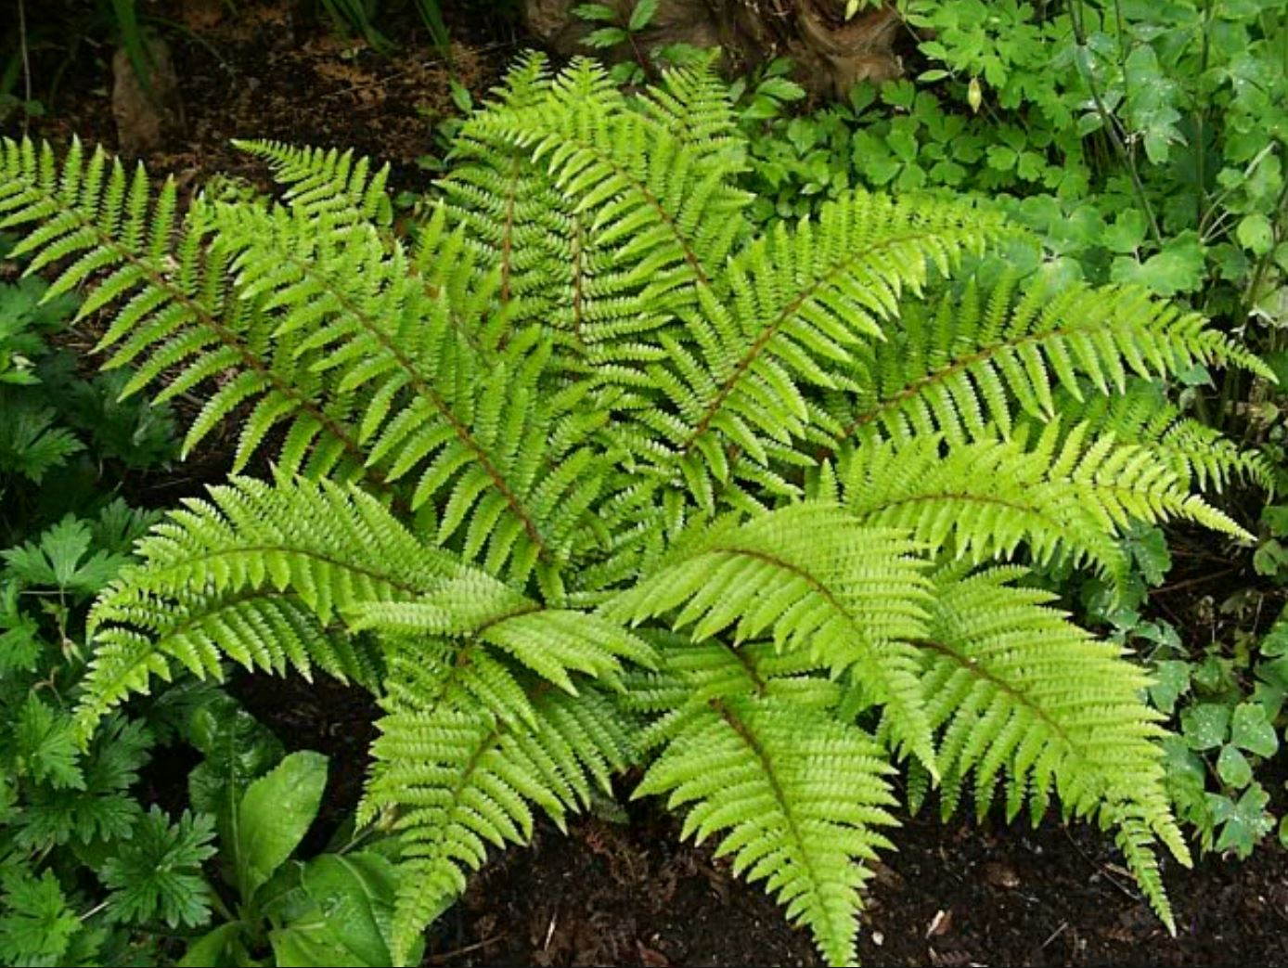
where once the ferns unfurled and purple violets grew

Slide 6
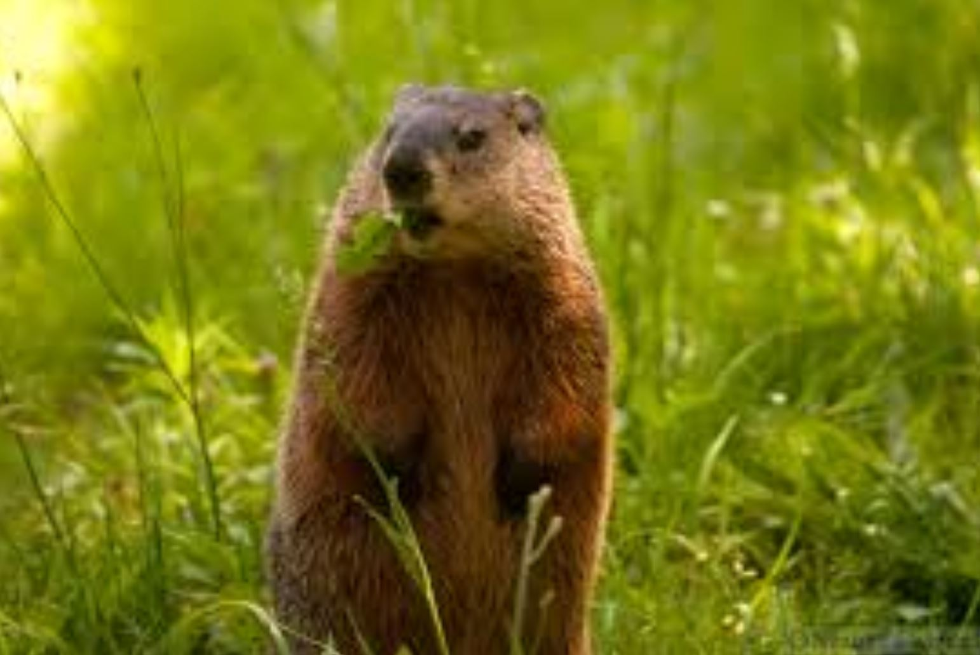
where once the woodchuck left his den to catch the morning dew

Slide 7
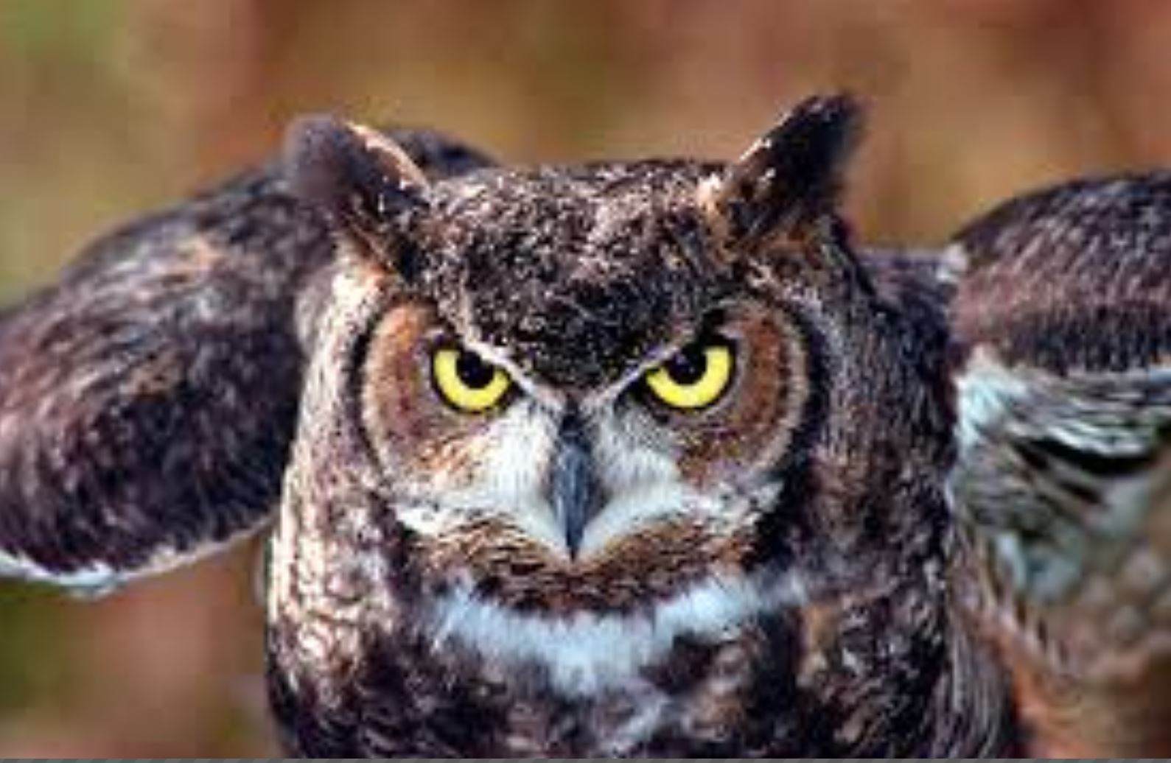
where once the horned owl hunted to feed her hungry brood

Slide 8
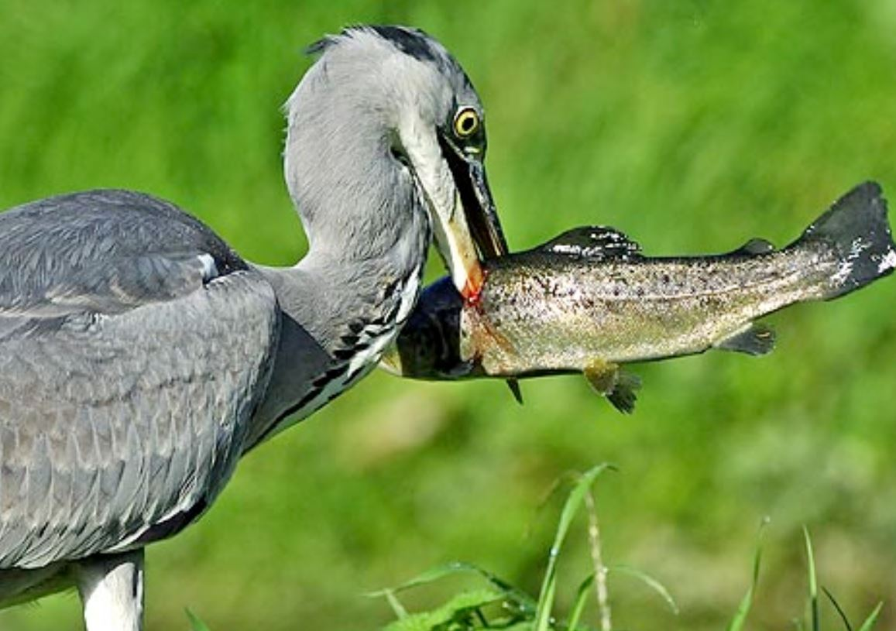
where once the heron fished and speared his glittering food

Slide 9
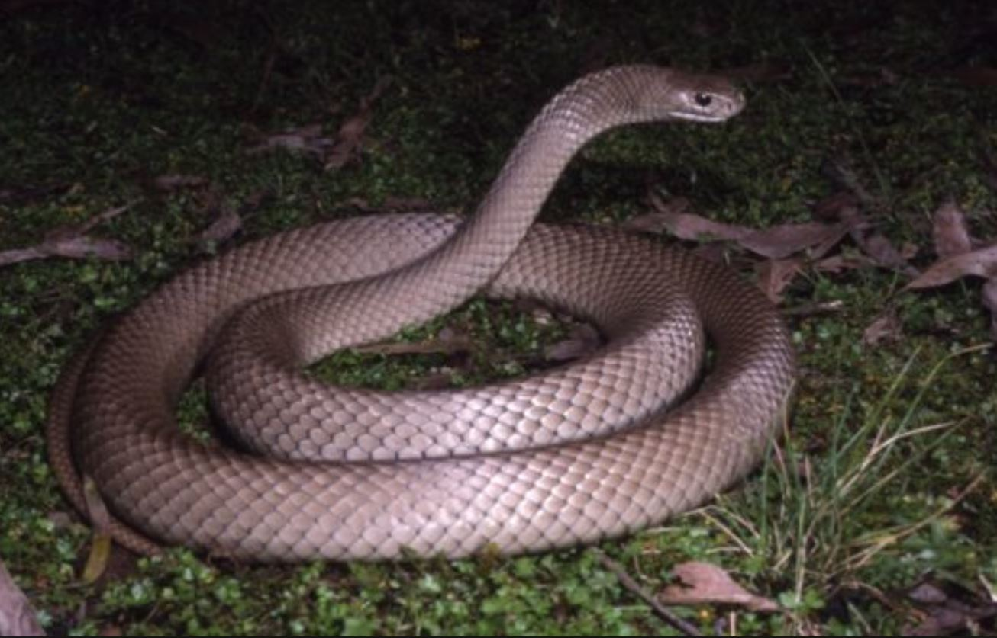
where once the brown snake slithered and slipped out of sight

Slide 10
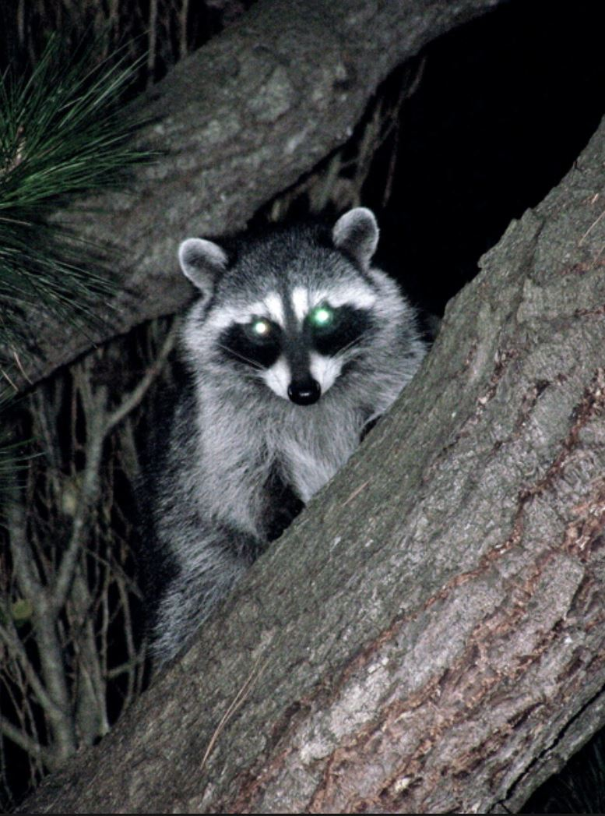
where once the raccoons rambled and rummaged in the night

Slide 11
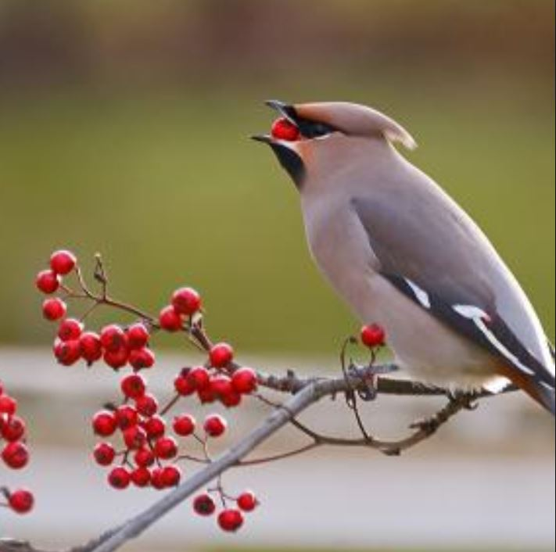
where once the berries ripened and waxwings came to feed

Slide 12
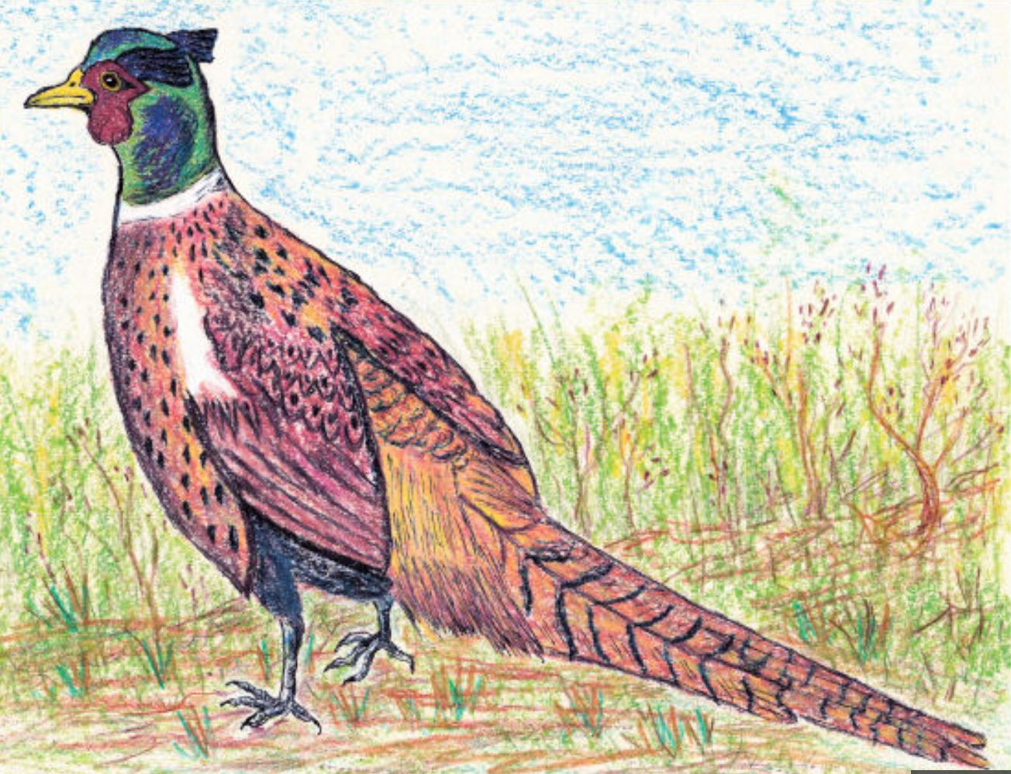
where once the pheasants roosted and fed on nuts and seed

Slide 13
Where once there was a wood a meadow and a creek

Slide 14
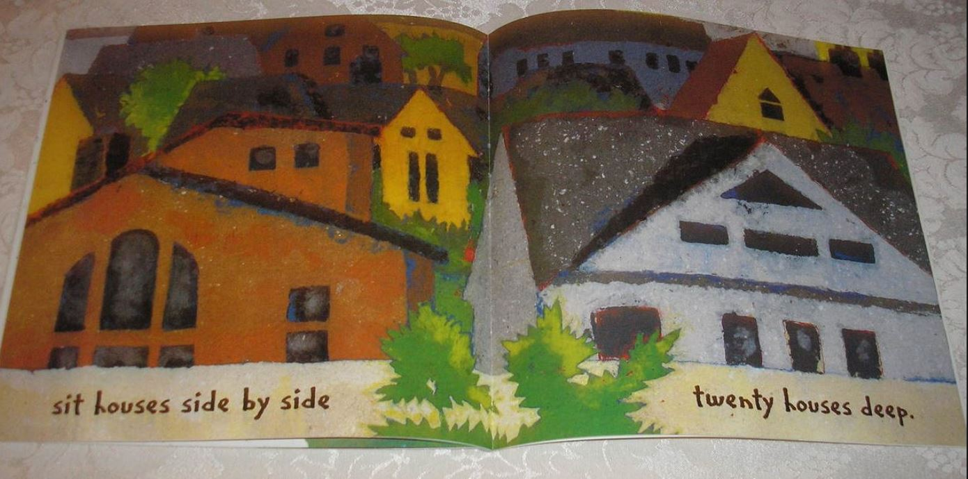
sit houses side by side twenty houses deep.

